Slide 1
How to connect with your members… so your members can connect with you
Mark Galauner
Financial Services Program Director
American Customer Satisfaction Index
Ann Arbor, MI
School of Communication
Cleveland State University
Cleveland, OH

Slide 2
Will I learn anything useful?
The importance of paying attention
How do credit unions compare to banks
Benefits of a satisfaction model vs random data
How to put a satisfaction model to work for you
Five things you can do right now

Slide 3
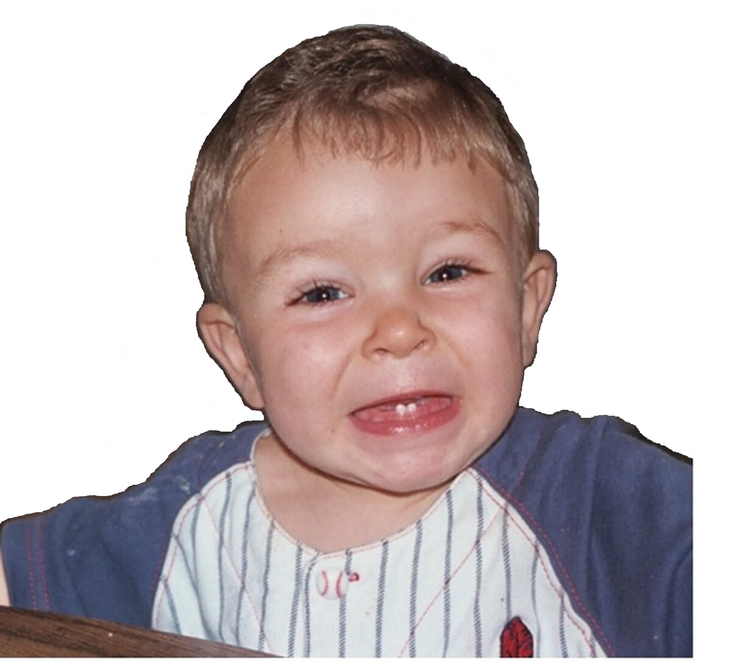
What I hear…..
“YOU GUYS ARE JUST LIKE A BANK”
Notes:
Review how Cus have traditionally scored higher overall and have excelled at personailzation

Slide 4
Credit Unions vs Banks Satisfaction
Banks have a slight advantage and scores are converging together

Slide 5
CREDIT UNION HISTORICAL STRENGTHS

Slide 6
Customer Service
The Credit Union advantage of the “personal touch” is eroding

Slide 7
Speed of Transaction
Personal touch includes getting things done quickly

Slide 8
BANK HISTORICAL STRENGTHS

Slide 9
Branch Locations
Credit Unions are catching up on branch location

Slide 10
ATM Locations
Same goes for ATM locations
Notes:
Probably affected by new post covid banking practices

Slide 11
Credit Union Satisfaction Model

Slide 12
Overall CU Satisfaction Model 2024
Satisfaction Drivers
84 | 2.0 | Mobile App
85 | 1.7 | Staff
83 | 1.5 | Website Satisfaction Index
79 | 1.2 | Account Information
81 | 0.9 | Financial Products
80 | 0.7 | Account Changes
76 | 0.1 | Branch
77 | 0.1 | ATM Convenience
Future Behaviors
Likelihood to Recommend | 4.6 | 80
Likelihood to Choose Again | 4.4 | 81
79
Overall Satisfaction: 81
Compared to Expectations: 77
Compared to Ideal: 77
Scores represent your performance as rated by employees
Impacts show you which driver has the most/least leverage – where improvements matter most/least to your members
Notes:
N=218

Slide 13
Ages 42-57 CU Satisfaction Model
Satisfaction Drivers
85 | 2.4 | Mobile App
86 | 1.5 | Staff
89 | 1.4 | Website Satisfaction Index
82 | 1.1 | Account Information
82 | 0.8 | Financial Products
82 | 0.4 | Account Changes
76 | 0.1 | Branch
77 | 0.0 | ATM Convenience
Future Behaviors
Likelihood to Recommend | 5.3 | 84
Likelihood to Choose Again | 5.2 | 83
81
Overall Satisfaction: 84
Compared to Expectations: 79
Compared to Ideal: 81
Scores represent your performance as rated by employees
Impacts show you which driver has the most/least leverage – where improvements matter most/least to your members
Notes:
N-73 scores from portal impacts from run report

Slide 14
Ages 26-41 Satisfaction Model
Satisfaction Drivers
79 | 1.6 | Account Changes
81 | 1.5 | Staff
76 | 1.4 | Website Satisfaction Index
76 | 1.3 | Account Information
80 | 0.7 | Financial Products
80 | 0.0 | Mobile App
76 | 0.0 | Branch
76 | 0.0 | ATM Convenience
Future Behaviors
Likelihood to Recommend | 4.2 | 77
Likelihood to Choose Again | 3.6 | 75
76
Overall Satisfaction: 78
Compared to Expectations: 75
Compared to Ideal: 74
Scores represent your performance as rated by employees
Impacts show you which driver has the most/least leverage – where improvements matter most/least to your members
Notes:
N=59

Slide 15
Key Drivers for Improvement

Slide 16
Percentage of Complaints
Complaints have a HUGE impact on satisfaction
Credit Unions traditionally have fewer complaints

Slide 17
Complaint Resolution
10%
Resolution
Customers with a problem= 65 MSI
Customer with no problem =82 MSI
46%
Customers with resolved problem = 79 MSI
Customers with unresolved problem= 50 MSI

Slide 18
New for 2024
New Improved Metric!!!
Interest in financial well-being correlates to satisfaction

Slide 19
What Next?
“These things will make me happy”

Slide 20
Five Things to do Right Now
Pay Attention
Monitor Complaints
Distribute Feedback
Align Channels
Financial Well-being

Slide 21
Credit Unions vs Banks Retention
Follows a similar patter as satisfaction

Slide 22
Questions?
www.theacsi.org
mgalauner@cfigroup.com
That’s all Folks!
Mark Galauner
Program Director
American Customer Satisfaction Index

